Slide 1

Welcome to FireFlight!
Meet the Team:
Our team is composed of:
  Alyssa Ortiz- Team Lead, Hosting, Frontend
  Payton Watts- Data Querying, Backend
  Andrew Ortega- Web Development, Frontend
  Tyler Chapp- Data Visualization, Backend
Our clients:
  USDA Forest Service researchers
  NAU SICCS researchers
Mentor: Scott LaRocca
Notes:
Payton
Target Time: <30 seconds (current time is around: 60 seconds )

Slide 2

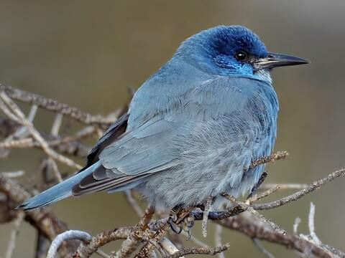
Problem Statement
Clients: Analyze data to determine likelihood of bird presence in an area post-fire
  Birds are an indicator species of an ecosystems health
  Valuable data for Western United States Forestry Management Stations
Clients currently produce and distribute all data + analysis manually
Need a user friendly tool to easily view and export the data on bird presence in an area
Notes:
Alyssa slow down!!!!
Target Time: 120 seconds (current time is around: 1min & 20-30sec)
Our clients analyze reported data on bird sightings in an area to determine the likelihood of bird presence in a given area
What this means is for example, at a certain spot, there could be a 30% chance that crows will be present.
This is important because birds are an indicator species that reflect an ecosystem’s health.
To determine which course of actions are best to take when maintaining an area, scientists need to first look at how bird populations change in response to natural disasters, especially wildfires.
This data analysis is used by Western United States Forestry Management Stations to help them determine how to properly take care of an area.
Currently, all stations must go through a single point to receive user-friendly analysis for over 10 years of collected data- our clients
They are producing and distributing all of this information manually each time a station requests data.
They need a a user friendly tool that they, and all of the research stations, can use to easily view and export the data on bird presence in an area
Each research station should be able to view and export the collected data on their own, and be able to understand the results in order to increase individual efficiency and free up our clients to work on other important projects, rather than dedicating lots of time to relaying information back and forth

Slide 3
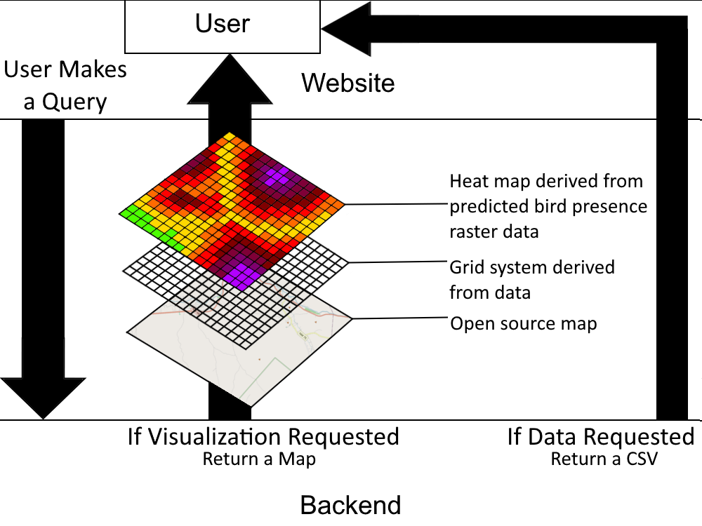
Solution Overview
What we’re building is a web app that allows users to query a database for bird presence prediction data, receiving it either as a CSV file, heat map, or both.
Notes:
Payton
Target Time: <30 seconds (current time is around: )

Slide 4
Solution Overview
Key features:
  Ease of access- users need an easy way to retrieve data/maps.
  Easy querying- users should be able to filter the data by species, region, etc.
  Clear visualization- heat maps and data files must be able to clearly visualize what the user wishes to show to forest managers and other officials.
  Security- due to being proprietary USDA information, the database must be safe and protected from cyber threats.
  Built for Future Maintenance- Our code must be readable, instructions for usage clear, and codebase easily maintainable.
Notes:
Payton
Target Time: <90 seconds (current time is around: )
Given that we will be handing off this project to a government agency for possibly long-term use…

Slide 5

Key Requirements
User-Friendly Interface
Data Querying & Filtering
Data Visualization
Exportable Results
Notes:
Tyler
Target Time: <60 seconds (current time is around: 35 seconds )
From working closely with our clients, we gathered 4 key requirements:
User interface that is easy to use for non-technical users
Users should be able to filter and query data such as by species
Bird & wildfire data needs to be transformed into a heatmap overlay then embedded in a web-based map
Users need the ability to download filtered data as CSV for further analysis

Slide 6
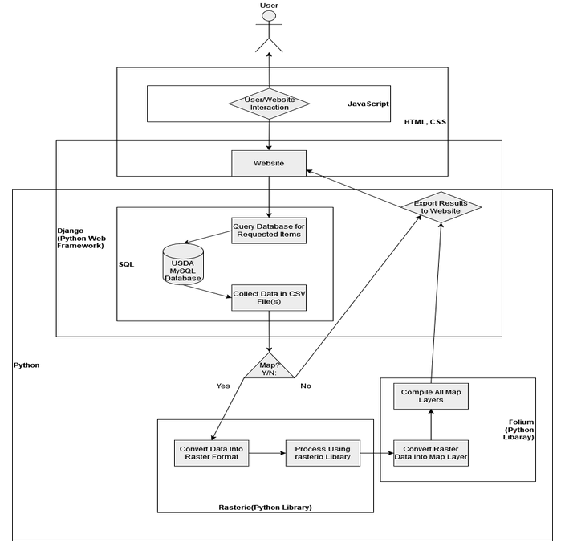
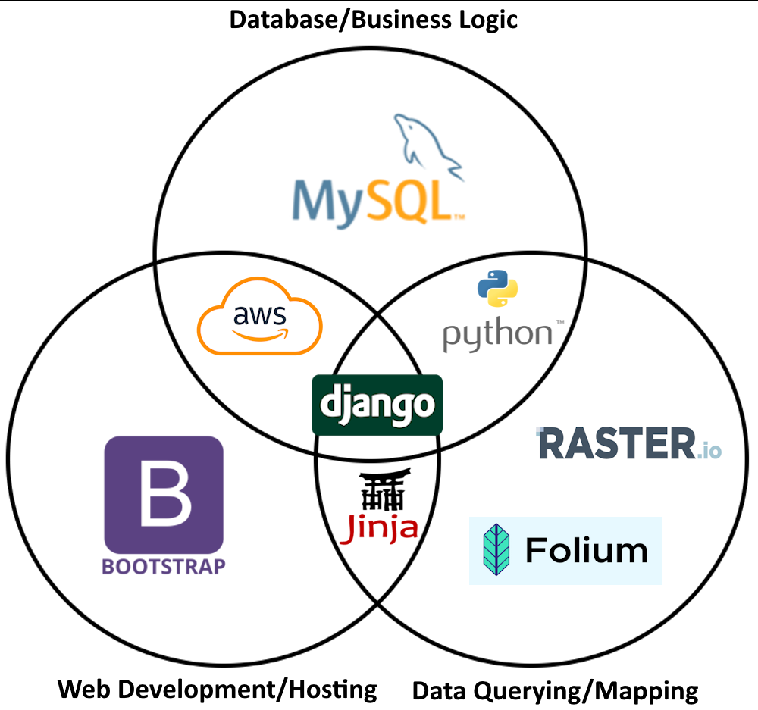
Architecture & Implementation Review
User Interface
Application Logic Module
Mapping & Visualization Module
Database Layer
Notes:
Tyler
Target Time: 120 seconds (current time is around: 90 seconds )
To meet these requirements, we built our system with the following 4 modules:
User Interface
Provides clear instructions to the user and interactive map displays
The UI sends HTTP requests to the Logic module
to apply dynamic filters and export data as CSV
This module was built with HTML/CSS/JavaScript and the Bootstrap library
Application Logic module
Overall manages data ingestion, processing, and query execution
Accomplishes this by converting CSV data for database storage
And handling HTTP requests from the User Interface to
Query data from the Database layer to prepare for Map Generation
This layer also generates our filtered, exportable results as CSV
and was built with Django and Python serving as our back-end frameworks
Mapping & Visualization Module
Starts by receiving queried data from the Logic and layer to
Render heatmap overlays and generate a web embedded map
This layer provides dynamic map updates to the User Interface
And was built using Rasterio and Folium python libraries
Database Layer
Store data in database for efficient retrieval
Return queried information to Logic Layer
And this module uses a MySQL database managed by Django

Slide 7
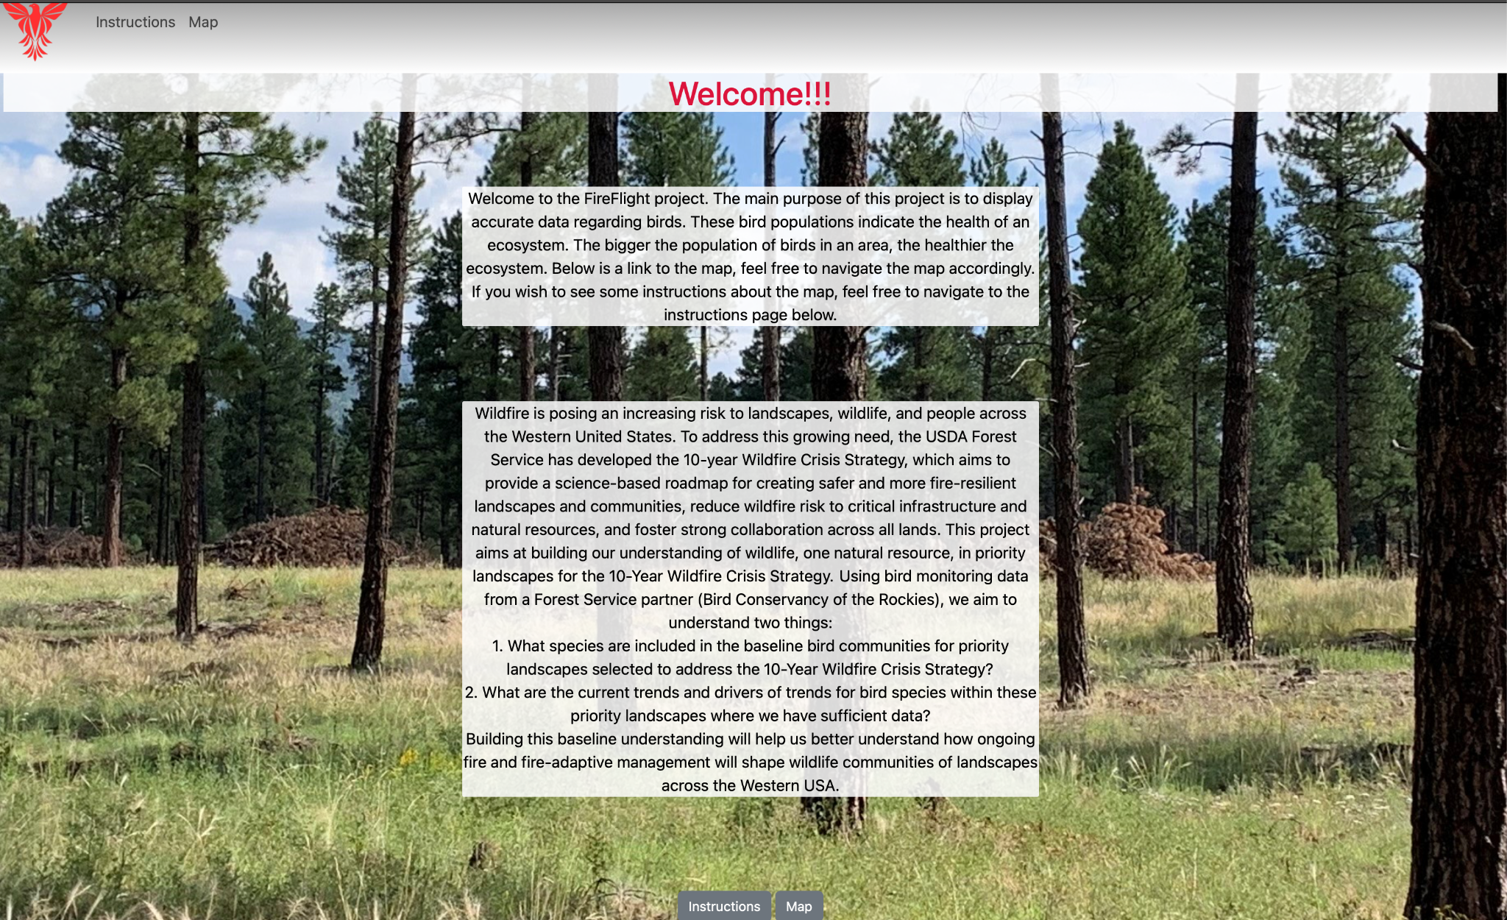
Intro
Notes:
Andy
Target Time: <20 seconds (current time is around: )
(Combined Demo Time: <4 minutes)
Use language to emphasize the product is basically done

Slide 8
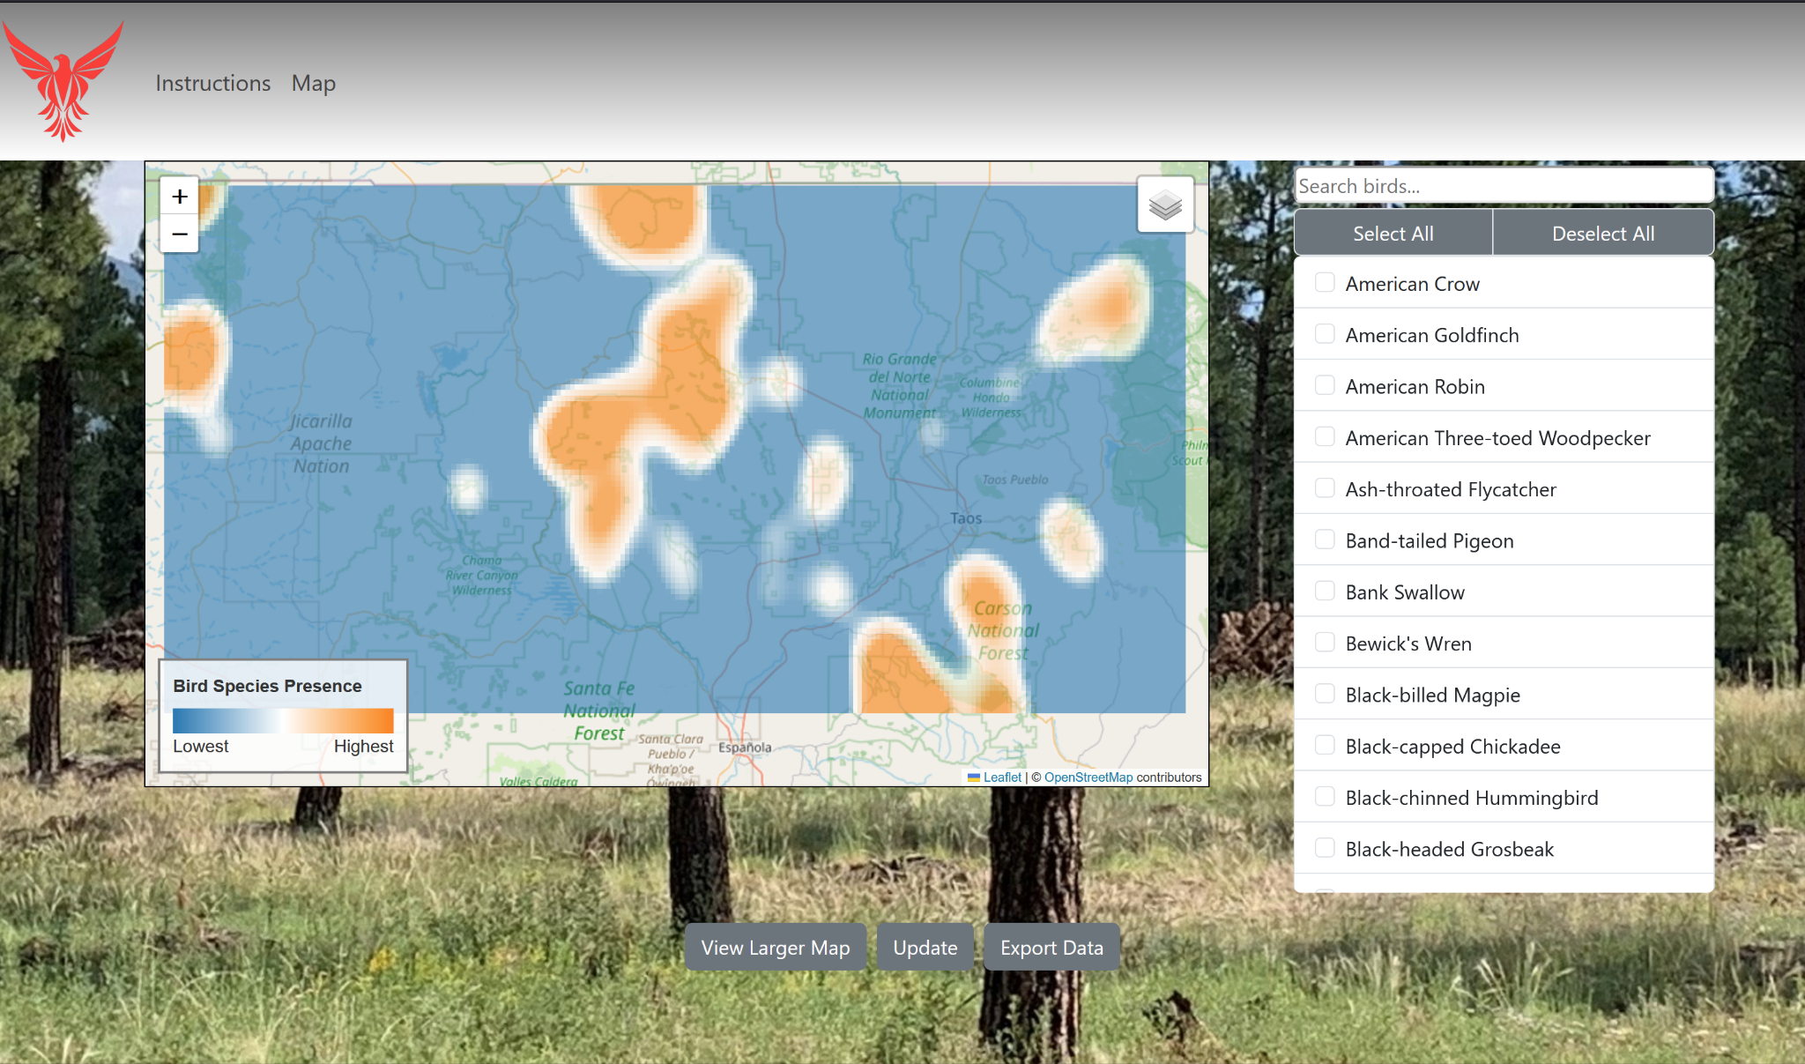
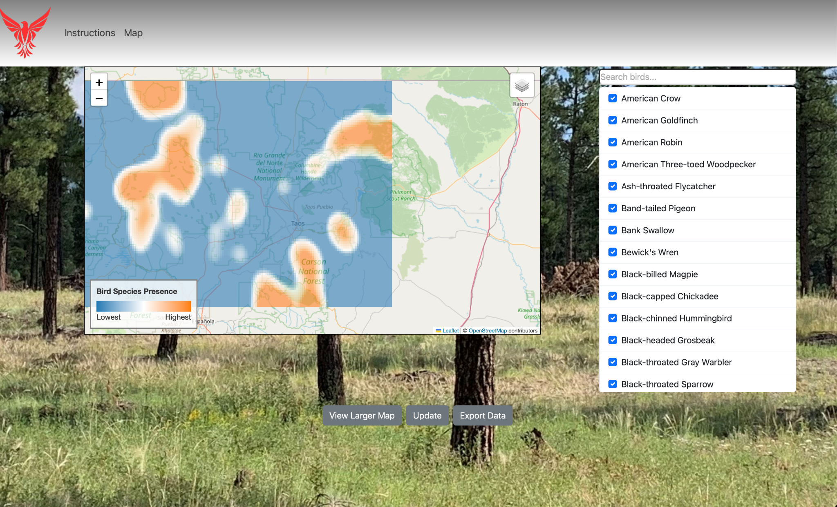
Map
Notes:
Andy, then transition to Alyssa
Total time: 45 seconds (current time is around: )
(Combined Demo Time: <4 minutes)
On the right is a list of all bird species that have data available. Once the chosen species are selected, you can click the update button to regenerate the map and export csv file.

Slide 9
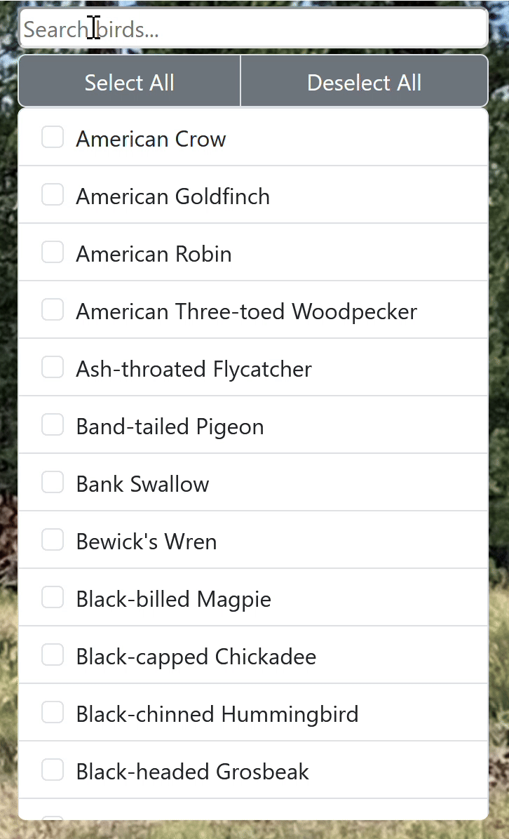
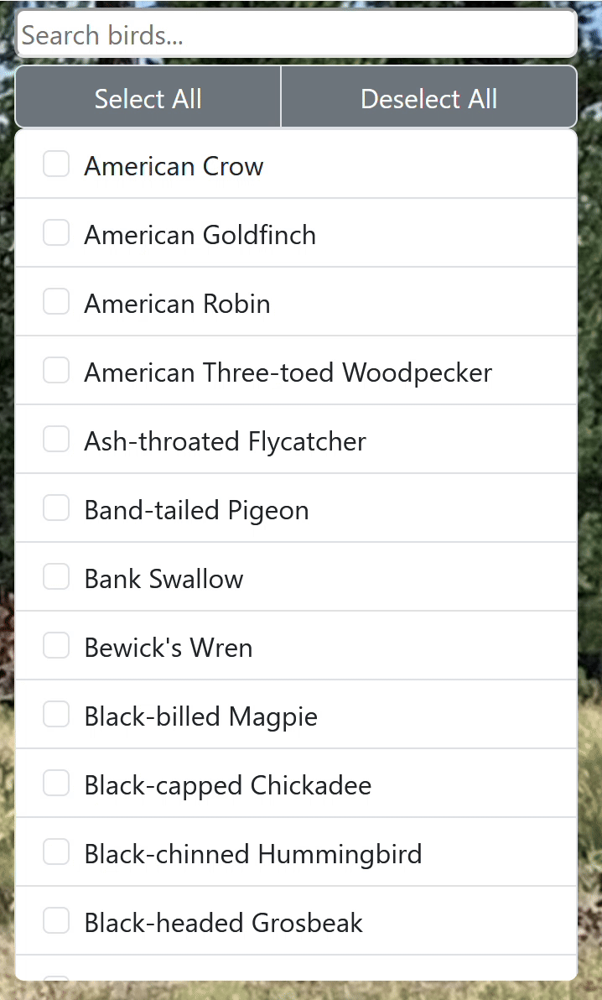
Live Search
Select/Deselect All
Notes:
Alyssa
Target Time: <30 seconds (current time is around: 30 seconds )
(Combined Demo Time: <4 minutes)
Here, you can see our live search feature, as well as our select and deselect all options. This is essential as there are currently about 100 different bird species in the list.

Slide 10
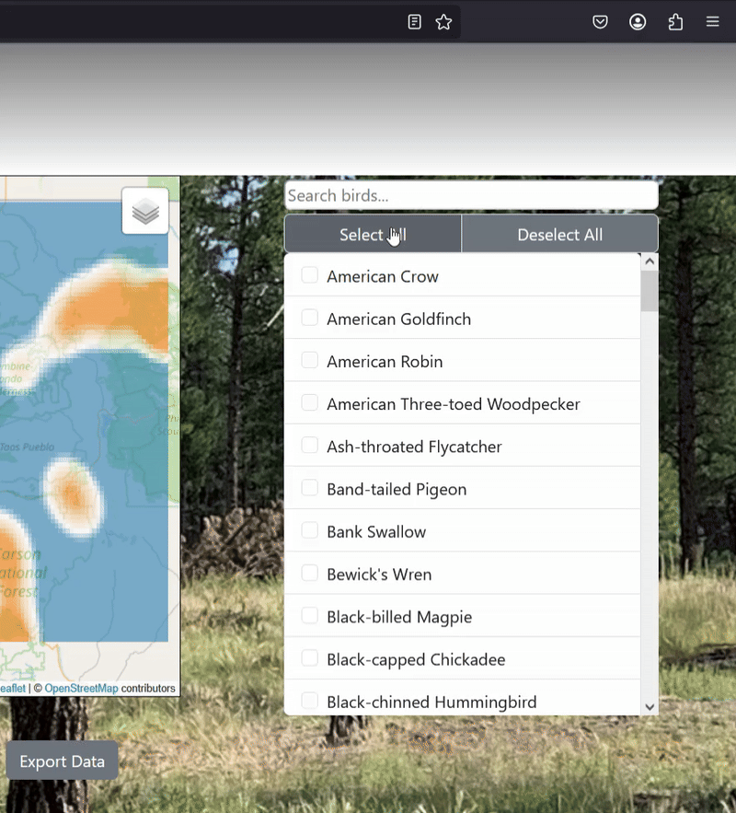
Clicking the export button
Notes:
Target Time: <45 seconds (current time is around: )
(Combined Demo Time: <4 minutes)
Payton
When a CSV of the database is requested via a button click, a querying view goes through the database and writes a CSV file containing elements such as the birds selected, their presence, and the specific grid being searched.
The view then promptly triggers a downloads of this output file through the users browser.

Slide 11
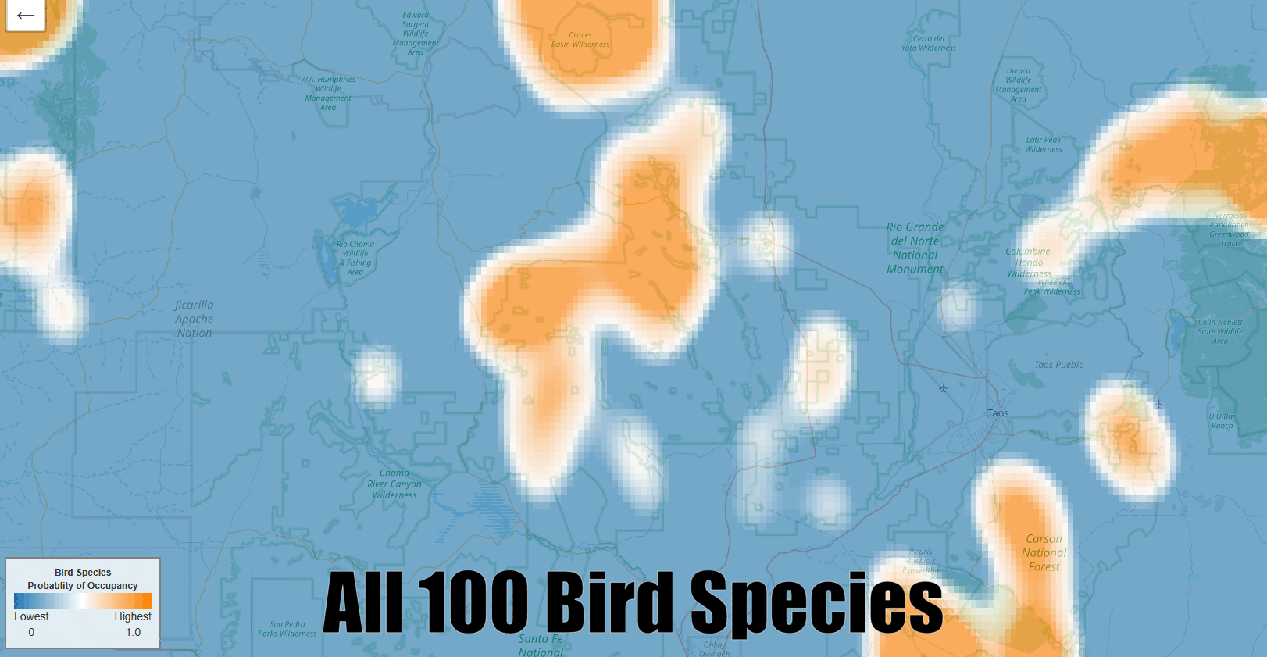
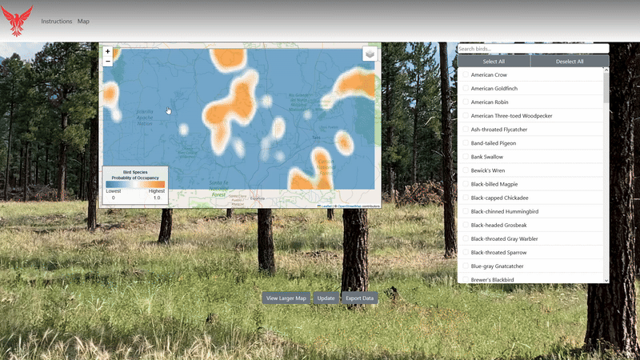
Map Generation
Map Navigation
Notes:
Target Time: <45 seconds (current time is around: 40 seconds )
(Combined Demo Time: <4 minutes)
Tyler
Now we will take a closer look at our map generation and visualization module:
ON THE LEFT, you’ll see the map generation in action
First, a heatmap displaying all species, followed by maps for individual species after filtering
This is powered by Raserio for converting raw data into raster format
And Folium to create interactive maps
The heatmaps use Gaussian smoothing to highlight areas of high bird presence and improve visual clarity
ON THE RIGHT, we demonstrate user interaction by zooming, panning, and opening full-screen mode
Showing how easy it is to explore the data dynamically

Slide 12
Populating the Database
Uses a Django custom command
Takes in a CSV file that properly corresponds to one of the three models we use
If there are no issues, the command will write the data into the appropriate table, updating values where necessary
Notes:
Target Time: <30 seconds (current time is around: )
(Combined Demo Time: <4 minutes)
Payton
Using a Django custom command we made, users can auto-populate their database, by combining the populate command with a CSV of proper format.
The command parses the file and ensures its contents follows one of the three Django data model standards.
If no errors are present, the file is written into the MySQL database table for that particular model.

Slide 13
Challenges and Resolutions
Regenerating the Map on Reload
  Potential Solution: Using caching to determine when to regenerate the map
Optimized for 1 user at a time
  Potential Solution: using unique session ids when generating maps and processing requests
Seamless transfer to clients
  Potential Solution: Detailed instructions for setup, use, maintenance, and error handling
Notes:
Alyssa Slow down!!!!
Target Time: <60 seconds (current time is around: 2 minutes)
Currently, we have a few ongoing challenges with our project.
As of now, our map regenerates every time the map page is reloaded.
A Potential Solution is to use caching to determine when to regenerate the map, preferably only when the user clicks the update button.
Currently, the website is only Optimized for 1 user at a time as it can only generate one map at a time.
A Potential Solution is to use unique session ids for each user when generating maps and processing requests
Because of the major restructuring of the US Forestry Department currently happening, it is very likely that our clients will initially have to set up and manage the website by themselves.
Because our clients are not as familiar with web development as we are, we need to create detailed documentation and instructions to ensure that they are able to properly set up, use, maintain, and fix any errors that may show up.

Slide 14
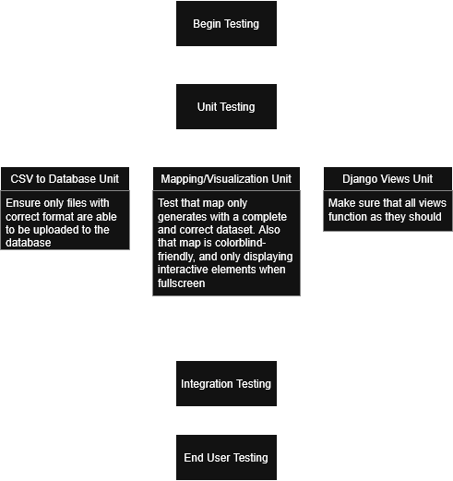
Testing Plan
Notes:
Payton
Time: <30 seconds (current time is around: 3 minutes )

Slide 15
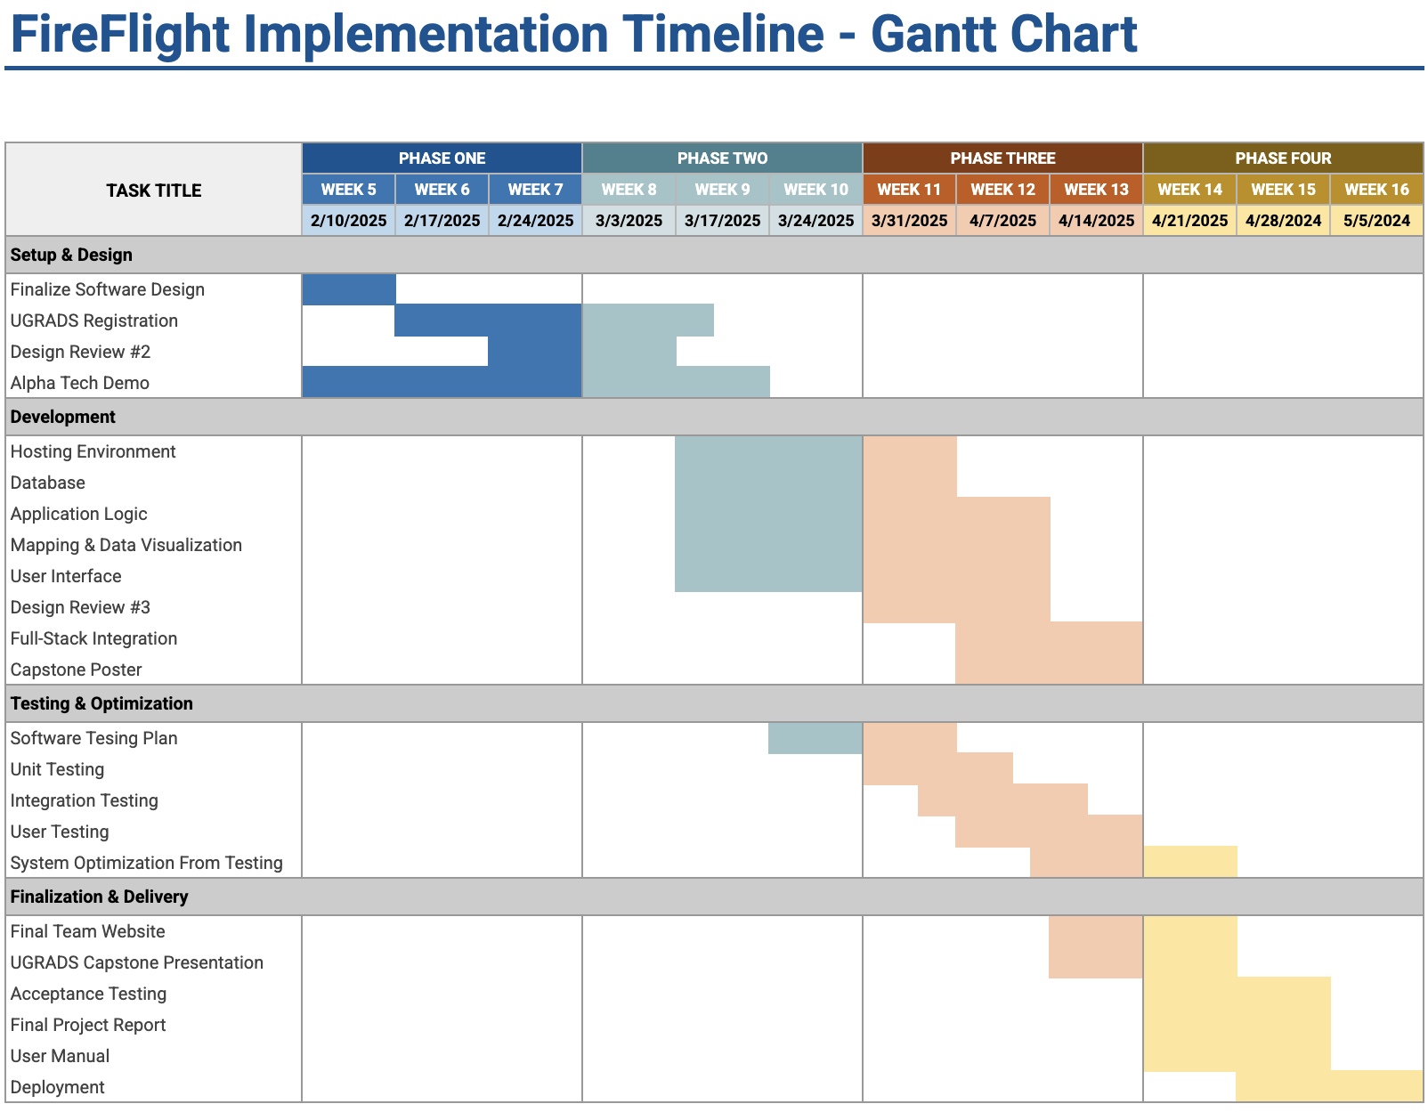
Schedule-
Notes:
Andy
Target Time: 30 seconds (current time is around: )
Say mvp is done
Mention multi-testing

Slide 16
Future Work
Select options for what to export
On/Off for the Gaussian model
Incorporate other data sets with different areas
Notes:
Andy
Target Time: <60 seconds (current time is around: )
Use language to emphasize the product is basically done
Future

Slide 17
Conclusion
A user friendly tool is needed to easily view and export the data on bird presence in an area after a fire occurs.
Our tool does just that.
Working closely with our client, we were able to get 100% of the requirements implemented into our project.
Our clients will be able to better understand and interpret the data that has been collected.
They are ecstatic with the work we have done.
Notes:
Andy
Target Time: <60 seconds (current time is around: )
Use language to emphasize the product is basically done

Slide 18
Any Questions?
Notes:
Alyssa
Thank you all for listening. Does anyone have any questions?

